Slide 1
National Weather Service
2nd Global Observation Data Exchange for NWP Meeting
27-30 November 2018
New-Delhi, India
Fred Branski
NOAA/NWS, International Affairs Office
November 2018

Slide 2
Mission & Vision
NWS Mission: Provide weather, water, and climate data, forecasts and warnings for the protection of life and property and enhancement of the national economy.
NWS Vision: A Weather-Ready Nation, a society that is prepared for and responds to weather-dependent events.
NWS/IAO Vision: Effective international coordination such that society is ready, responsive and resilient to weather-dependent events

Slide 3
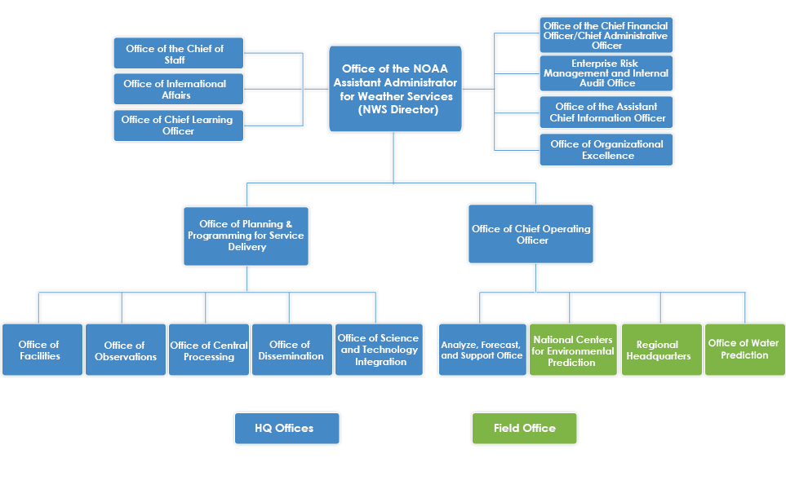
NWS Organizational Structure
https://www.weather.gov/organization/

Slide 4
Strategic Objectives
Objectives:
Respond to the rapidly growing demand for environmental information as technology advances and population and environmental stresses increase.
Respond to increasing demand for integrated environmental prediction services and the global move toward impact-based forecasting.
Fully integrate and formalize coordination of the International Crosscut within NWS Governance

Slide 5
Activities to Achieve Vision
Objective: Respond to rapidly growing demand for environmental information as technology advances and population and environmental stresses increase.
Improve quality and quantity of observations through the WMO Integrated Global Observing System (WIGOS)
Metadata management - Improve compliance with international requirements (OBS)
Availability and quality monitoring - Implementation of Regional WIGOS Center (OBS)
Engagement to formulate a coordinated future observations strategy by updating and strengthening WIGOS (OBS)
Improve the availability and usefulness of data and products through the WMO Information System
Cyber Security Coordination - Implement and build on trilateral cooperation with UK and Australia (DIS, CP, CIO)
Lifecycle information management - Improve compliance with international requirements (DIS/STI)
ICAO Meteorological Information Exchange Model (IWXXM) - continue compliance with aviation specifications. Version 3.0 deployment in 2019. (DIS/NCEP)
WIS 2.0 (Implementation beginning 2020) - Evaluate move to cloud based, web services architecture (DIS/STI)

Slide 6
Activities to Achieve Vision
Objective: Respond to increasing demand for integrated environmental prediction services and the global move toward impact-based forecasting.
Advance and integrate science from Grand Challenges and THORPEX legacy projects (STI)
Polar Prediction Project - Arctic Test Bed and YOPP Activities
High Impact Weather - Contribute to NOAA High Impact Weather Prediction Project
Seasonal to Sub-seasonal - Contribute to NOAA Sub-seasonal to Seasonal Prediction Task Force
Contribute to design of Future Global Data Processing and Forecasting System (AFS, STI, DIS)
Engage WMO Open Program Area Group on Data Processing and Forecasting System (OPAG-DPFS) to develop future design and implementation plan
Work with key partners to influence future GDPFS design
Coordinate international implementation of IDSS (AFS)
Engage WMO Open Program Area Group on Public Weather Services (OPAG-PWS)
Achieve interoperability of US and international impacts catalogue
Continue strong involvement with WMO and key partners in the delivery of services for aviation, tsunami, space weather and arctic domains
Develop a WMO Regional Climate Center (RCC) capability our region (North and Central America and the Caribbean) and contribute towards WMO RCCs across the Arctic and Pacific

Slide 7
Activities to Achieve Vision
Objective: Fully integrate and formalize coordination of the International Crosscut within NWS Governance.
Portfolio Engagement: OCOO, OPPSD, OBS, CP, AFS, STI
International commitments collaboration
Annual Operating Plan milestone development
Corporate travel planning
Definition of metrics to track qualitative benefits of engagement
OCOO, Office of the Chief Operating Officer
OPPSD, Office of Planning & Programming for Service Delivery
OBS, Observations
CP, Central Processing
AFS, Analyze, Forecast & Support
STI, Science & Technology Integration
About the NWS

